Slide 1
Lecture 20. Shortest Paths
CpSc 212: Algorithms and Data Structures
Brian C. Dean
School of Computing
Clemson University
Fall, 2012

Slide 2
Types of Shortest Path Problems
Single-source single-destination: find the shortest path from s to t in a (directed) graph.
Single-source: find the shortest path from s to every other node in a (directed) graph.
All-pairs: find the shortest path from every node to every other node.

Slide 3
Single-Source Shortest Paths
11
Input:
Directed graph with
costs/weights/lengths on its edges.
Output:
c[j]: cost of shortest s → j path
pred[j]: previous node (before j) on a shortest s → j path.
1
2
9
12
3
s
4
5
5
2
6
1
3
4
8
c[1] = 6
c[2] = 17
11
1
2
3
pred[5] = 4
s
4
5
c[5] = 15
2
6
3
4
c[3] = 2
c[4] = 9

Slide 4
Single-Source Shortest Paths:
Algorithms
Easy cases that we can solve in linear time:
Unweighted graphs: use breadth-first search.
Directed acyclic graphs (DAGs): use dynamic programming.
If edge costs are nonnegative, we’ll use Dijkstra’s algorithm.
If some edge costs are negative, we use the Bellman-Ford algorithm.

Slide 5
Breadth-First Search
Depth-first search dives as deeply as possible into a graph until it can go no further, then it backs up and tries to branch.
In contrast, a breadth-first search (BFS) starting at some source node s will visit s, then all nodes 1 hop away from s, then all nodes 2 hops away from s, etc.
Like DFS, we can also use BFS to find connected components or answer “find a path from i to j” queries.
BFS finds a path from i to j having fewest edges.

Slide 6
Breadth-First Search
BFS(s):
For all nodes i:
pred[i] = null
dist[i] = Infinity
Q = {s}
dist[s] = 0
While Q is nonempty:
i = next node in Q
For all nodes j such that (i,j) is an edge:
If dist[j] = Infinity,
pred[j] = i
dist[j] = dist[i] + 1
Append j to the end of Q
If Q is implemented as a stack rather than as a FIFO queue, we get DFS rather than BFS!

Slide 7
Negative-Cost Cycles
If negative-cost edges exist:
We need to use the O(mn) Bellman-Ford algorithm.
We can only find shortest paths if there are no negative-cost directed cycles (Bellman-Ford can at least detect whether negative cycles exist).
If our graph is undirected, we typically assume it has no negative-cost edges to begin with.
Longest path problems convert to shortest path problems by negating edge lengths, so positive-cost cycles are bad for these problems
So longest path problems are rarely tractable, since most graphs have positive-cost cycles.
Except DAGs, that is…

Slide 8
Updating Cost Labels
+∞
+∞
11
1
2
9
12
3
0
s
4
5
5
+∞
2
6
1
3
4
8
+∞
+∞
Initially, all nodes have cost labels set to +∞, except the source, which has cost label 0.
We’d like to improve the cost labels of all nodes so they reflect the costs of shortest paths.

Slide 9
Dijkstra’s Algorithm – Example
+∞
+∞
11
1
2
9
12
3
0
s
4
5
5
+∞
2
6
1
3
4
8
+∞
+∞
Initialization.

Slide 10
Improving Cost labels
Shortest path costs satisfy the triangle inequality:
c[i] + cost(i, j) ≥ c[j] for every edge (i, j).
If this is violated for some edge (i, j), we can improve the cost label of node j:
c[i]
i
cost(i, j)
x
y
z
s
j
x + y ≥ z
c[j]
Tighten(i, j): (also called Relax(i, j))
If c[i] + cost(i, j) < c[j],
c[j] = c[i] + cost(i, j)
pred[j] = i

Slide 11
The Bellman-Ford Algorithm
Bellman-Ford:
c[s] = 0, c[j ≠ s] = +∞
Repeat n-1 times:
Tighten every edge in the graph
If c[i] + cost(i, j) < c[j] for any edge (i, j)
Output “negative cycle detected!”
O(mn) time.
Computes single-source shortest paths in the presence of negative edge costs, and can detect negative cycles.
Analyze using induction: after k iterations of the main loop, each label c[j] reflects the cost of the shortest k-hop path from s to j.

Slide 12
Dijkstra’s Algorithm
Dijkstra:
c[s] = 0, c[j ≠ s] = +∞
Build a priority queue Q on the c[j]’s
While Q is nonempty:
Remove from Q the node i having minimum label c[i]
(at this point we know c[i] is correct)
Tighten all edges emanating from i
Only works if edge costs are nonnegative.
Running time depends on priority queue:
n inserts (during initialization)
n remove-mins
at most m decrease-keys
Using a binary heap, all these opeartions run in O(log n) time, so total is O(m log n).

Slide 13
Dijkstra’s Algorithm – Example
+∞
+∞
11
1
2
9
12
3
0
s
4
5
5
+∞
2
6
1
3
4
8
+∞
+∞
Initialization.

Slide 14
Dijkstra’s Algorithm – Example
9
+∞
11
1
2
9
12
3
0
s
4
5
5
+∞
2
6
1
3
4
8
2
+∞
Examine the source node s, so s becomes “permanently” labeled.
Tighten all edges leaving s.

Slide 15
Dijkstra’s Algorithm – Example
6
+∞
11
1
2
9
12
3
0
s
4
5
5
+∞
2
6
1
3
4
8
2
10
Examine node 3, which becomes permanently labeled.
Tighten all edges leaving node 3.

Slide 16
Dijkstra’s Algorithm – Example
6
17
11
1
2
9
12
3
0
s
4
5
5
+∞
2
6
1
3
4
8
2
9
Examine node 1, which becomes permanently labeled.
Tighten all edges leaving node 1.

Slide 17
Dijkstra’s Algorithm – Example
6
17
11
1
2
9
12
3
0
s
4
5
5
15
2
6
1
3
4
8
2
9
Examine node 4, which becomes permanently labeled.
Tighten all edges leaving node 4.

Slide 18
Dijkstra’s Algorithm – Example
6
17
11
1
2
9
12
3
0
s
4
5
5
15
2
6
1
3
4
8
2
9
Examine node 5, which becomes permanently labeled.
Tighten all edges leaving node 5 (there aren’t any).

Slide 19
Dijkstra’s Algorithm – Example
6
17
11
1
2
9
12
3
0
s
4
5
5
15
2
6
1
3
4
8
2
9
Examine node 2, which becomes permanently labeled.
Algorithm terminates!

Slide 20
Dijkstra’s Algorithm – Correctness
Just like BFS, Dijkstra visits all nodes in increasing order of distance from the source, and visits each node exactly once.
Think of Dijkstra as maintaining two sets:
S: visited nodes that are “permanently” labeled.
T: remaining nodes that are temporarily labeled (whose cost labels are still upper bounds)
Every iteration takes the node from T with minimum label and adds it to S.
Claim: when we visit node i, c[i] will be the correct shortest path cost from s to i.

Slide 21
Dijkstra’s Algorithm – Running Time
The unsorted array is better for a dense graph, and the binary heap is better for a sparse graph.
The Fibonacci heap bound is always at least as good as both other bounds in any graph!
In practice, however, Fibonacci heaps are so complicated that it’s hard to find instances for which they run faster…
 | Remove-Min O(n) times | Decrease Key O(m) times | Total Runtime
Unsorted Array | O(n) | O(1) | O(n²)
Binary Heap | O(log n) | O(log n) | O(m log n)
Fibonacci Heap | O(log n) | O(1) amortized | O(m + n log n)

Slide 22
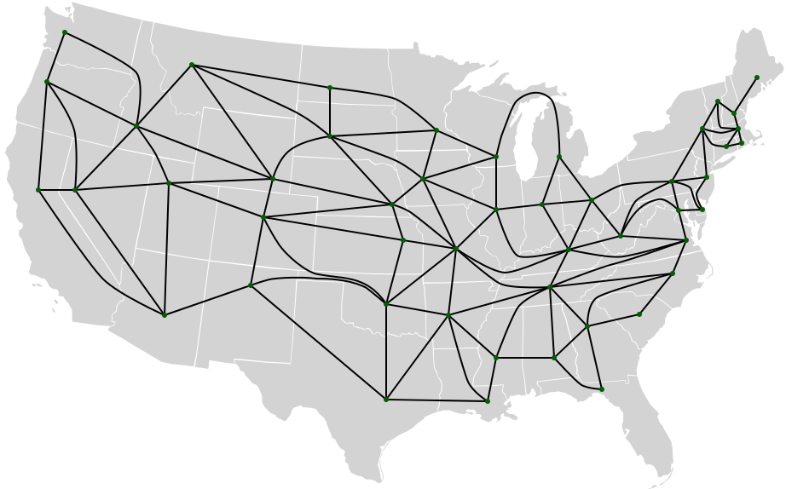
Recall: Centrality
What nodes are most “central” in a graph?

Slide 23
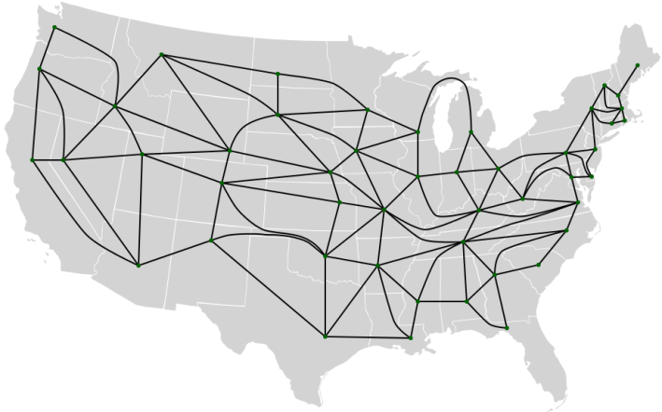
Centrality & Shortest Paths
Many notions of centrality are based on shortest paths:
Eccentricity(x) = max dist(x,y) over other nodes y; a graph “center” is a node with minimum eccentricity.
“Betweenness” centrality of an edge or node: fraction of all point-to-point shortest paths passing through that edge/node.
Other prominent notions of centrality include:
Degree centrality: high degree treated as “more central”
Eigenvector centrality (centrality proportional to probability a node is visited by a random walk in steady state); used by Google Pagerank.

Slide 24
Formulating Shortest Path Problems:
Change the Problem, not the Algorithm…
In an automobile transportation network, suppose right turns can be made instantly, while left turns take 1 extra unit of time…

Slide 25
Formulating Shortest Path Problems:
Change the Problem, not the Algorithm…
In an automobile transportation network, suppose right turns can be made instantly, while left turns take 1 extra unit of time…
Suppose we have N jobs to complete. Each job has a duration and possibly a set of prerequisite jobs. Working in parallel, how quickly can we finish all the jobs?

Slide 26
Formulating Shortest Path Problems:
Change the Problem, not the Algorithm…
In an automobile transportation network, suppose right turns can be made instantly, while left turns take 1 extra unit of time…
Suppose we have N jobs to complete. Each job has a duration and possibly a set of prerequisite jobs. Working in parallel, how quickly can we finish all the jobs?
Suppose some roads charge a $1 toll. How do we find a shortest path if we can pay at most $3 worth of tolls?

Slide 27
Formulating Shortest Path Problems:
Change the Problem, not the Algorithm…
In an automobile transportation network, suppose right turns can be made instantly, while left turns take 1 extra unit of time…
Suppose we have N jobs to complete. Each job has a duration and possibly a set of prerequisite jobs. Working in parallel, how quickly can we finish all the jobs?
Suppose some roads charge a $1 toll. How do we find a shortest path if we can pay at most $3 worth of tolls?
What is the second-shortest s-t path?

Slide 28
Postage
We have N different denominations of stamps (e.g., 1 cent, 23 cent, 47 cent).
We can use as many stamps of each denomination as we wish.
What is the minimum number of stamps we need in order to construct exactly C cents worth of postage?

Slide 29
“Knapsack” Problems
We have N items, with values v₁…v_{n} and integer sizes s₁…s_{n}.
What is the maximum value we can pack into a knapsack of capacity C?
… if we can include multiple copies of the same item?
… if we can only include at most 1 copy of each item?

